Slide 1
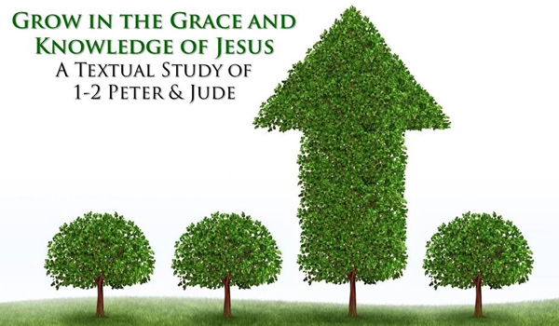
Growing As Children of Light
Notes:
This graphic came from Jason Hardin. This graphic came from Jason Hardin. I am certain have I have used notes from Mark Copeland’s EO series, Randy Yerby, Aaron Fleenor and other in making these powerpoints. Further, images have been used from the internet that remain property of their owners. This can not be sold or used commercially. It can only be used for classroom (Bible class) purposes.

Slide 2
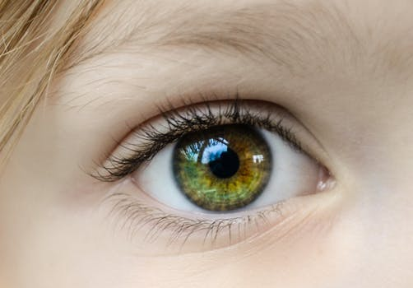

Eyeing Second Peter
Building On God’s Promises
Escaping the Corruption in the World
Partaking of the Divine Nature
Week 1
Notes:
I am certain have I have used notes from Mark Copeland’s EO series, Randy Yerby, Aaron Fleenor and other in making these powerpoints. Further, images have been used from the internet that remain preoprty of their owners. This can not be sold or used commercially. It can only be used for classroom (Bible class) purposes.

Slide 3

Eyeing Second Peter
Weekly study plan:
Read 2 Peter once a week
Work on the memory verse by reading it carefully aloud at least eleven times this week
Any study on next weeks topic in the text from next week’s topic: Sin and Grace

Slide 4
Memory Passage For This Quarter’s Class
2 Peter 1:3-4 According as his divine power hath given unto us all things that pertain unto life and godliness, through the knowledge of him that hath called us to glory and virtue: Whereby are given unto us exceeding great and precious promises: that by these ye might be partakers of the divine nature, having escaped the corruption that is in the world through lust.

Slide 5
Introduction
Generally, Peter accepted as author, although many have challenged. For more extensive discussion, see Hamilton.
Written between 65-68 AD (Peter’s death ~68 AD)
Written to Gentile Christians in Asia Minor (see 1 Peter 1:1), but not specified.
Expecting his death, Peter purposed to strengthen Christians against false teachers and to be steadfast in their faith and growth.
Theme: Spiritual growth by remembrance, warnings against false teachers and false doctrines.

Slide 6
Introduction: Remembering Second Peter Three Point Mnemonics
#1 Eyeing 2 Peter
Blindness and Myopia Control
Eyes Full of Adultery
Twinkling of an Eye
#2H: Holiness – Heresy – Hope
#3C:
Cultivate Christian Character
Condemnation of false teachers
Confidence in Christ’s return

Slide 7
Build on God’s Promises Growing As Children of Light
2 Peter 1:2-13 Simon Peter, a servant and an apostle of Jesus Christ, to them that have obtained like precious faith with us through the righteousness of God and our Saviour Jesus Christ: Grace and peace be multiplied unto you through the knowledge of God, and of Jesus our Lord,³ According as his divine power hath given unto us all things that pertain unto life and godliness, through the knowledge of him that hath called us to glory and virtue:⁴ Whereby are given unto us exceeding great and precious promises: that by these ye might be partakers of the divine nature, having escaped the corruption that is in the world through lust.⁵ And beside this, giving all diligence, add to your faith virtue; and to virtue knowledge;⁶ And to knowledge temperance; and to temperance patience; and to patience godliness;⁷ And to godliness brotherly kindness; and to brotherly kindness charity.⁸ For if these things be in you, and abound, they make you that ye shall neither be barren nor unfruitful in the knowledge of our Lord Jesus Christ.⁹ But he that lacketh these things is blind, and cannot see afar off, and hath forgotten that he was purged from his old sins.¹⁰ Wherefore the rather, brethren, give diligence to make your calling and election sure: for if ye do these things, ye shall never fall:¹¹ For so an entrance shall be ministered unto you abundantly into the everlasting kingdom of our Lord and Saviour Jesus Christ.¹² Wherefore I will not be negligent to put you always in remembrance of these things, though ye know them, and be established in the present truth.¹³ Yea, I think it meet, as long as I am in this tabernacle, to stir you up by putting you in remembrance;

Slide 8
Introduction: An Overview
Verse 1 ….obtained like precious faith with us through the righteousness of God and our Saviour Jesus Christ
Faith “in reference to Christ, it denotes a strong and welcome conviction or belief that Jesus is the Messiah, through whom we obtain eternal salvation into the kingdom of God” Thayer 514
Notes:
Mark Copeland’s Executable Outlines were used and copied in preparation of some of this material.

Slide 9
Introduction
Verse 1 ….obtained like precious faith with us through the righteousness of God and our Saviour Jesus Christ
Righteousness “in the broad sense, the state of him who is such as he ought to be, righteousness… the condition acceptable to God… the state accptable to God which becomes a sinner’s possession through that faith by which he embraces the grace of God offered him in the death of Jesus Christ … in closer sense, justice, or the virtue which gives each one his due;” Thayer 149-150

Slide 10
Introduction
Verse 1 ….obtained like precious faith with us through the righteousness of God and our Saviour Jesus Christ
Righteousness
Contrast with Lewski “the one is not possessive; righteousness belonging to Chist, and the other is objective: knowledge that knows Christ”
The idea is righteousness flows from God and through Christ.
Grace and peace come through knowing

Slide 11
Grace and Peace Are Multiplied
Verse 2: Grace and peace be multiplied unto you through the knowledge of God, and of Jesus our Lord,
Grace and peace are common forms of greeting in the New Testament.
Grace - a greeting which requests God's unmerited favor upon the person addressed
Peace - a greeting requesting the natural result of God's favor.
Notes:
Grace is when you get something you do not deserve (salvation)
Mercy is when you do not get something you do deserve (condemnation).

Slide 12
Grace and Peace Are Multiplied
All experience God’s grace and peace to some degree.
Matthew 5:45. (That ye may be the children of your Father which is in heaven: for he maketh his sun to rise on the evil and on the good, and sendeth rain on the just and on the unjust.)
Only in Christ can one enjoy the full measure of God's favor and peace.
Ephesians 1:3 Blessed be the God and Father of our Lord Jesus Christ, who hath blessed us with all spiritual blessings in heavenly places in Christ:
Philippians 4:6-7 Be careful for nothing; but in every thing by prayer and supplication with thanksgiving let your requests be made known unto God.⁷ And the peace of God, which passeth all understanding, shall keep your hearts and minds through Christ Jesus.

Slide 13
Introduction
Verse 2 Grace and peace be multiplied unto you through the knowledge of God, and of Jesus our Lord,
One final command
2 Peter 3:18¹⁸ But grow in grace, and in the knowledge of our Lord and Saviour Jesus Christ. To him be glory both now and for ever. Amen.
What does it mean to grow in the knowledge of Jesus Christ?
How can we be sure that we are growing in this “knowledge”?

Slide 14
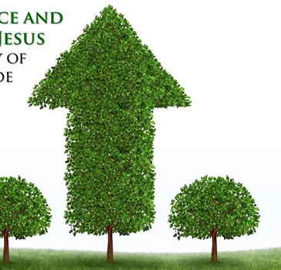
What It Means To Grow In the Knowledge of Jesus!
Knowledge is not just intellectual, but experiential from putting into it into practice
1 Jn 2:3-5 And hereby we do know that we know him, if we keep his commandments. He that saith, I know him, and keepeth not his commandments, is a liar, and the truth is not in him. But whoso keepeth his word, in him verily is the love of God perfected: hereby know we that we are in him.

Slide 15

God’s Gifts to His Children
2 Peter 1:3-4 ³ According as his divine power hath given unto us all things that pertain unto life and godliness, through the knowledge of him that hath called us to glory and virtue:⁴ Whereby are given unto us exceeding great and precious promises: that by these ye might be partakers of the divine nature, having escaped the corruption that is in the world through lust.
1 Cor 12:7 – to profit all - But the manifestation of the Spirit is given to every man to profit withal.
2 Tim 3:16-17 All scripture is given by inspiration of God, and is profitable for doctrine, for reproof, for correction, for instruction in righteousness:¹⁷ That the man of God may be perfect, thoroughly furnished unto all good works.

Slide 16

God’s Gifts to His Children
Consider some:
God’s word is a lamp to guide us
Prayer
God’s gift of Salvation and sacrifice of His Son, the Christ
The church to encourage and edify

Slide 17
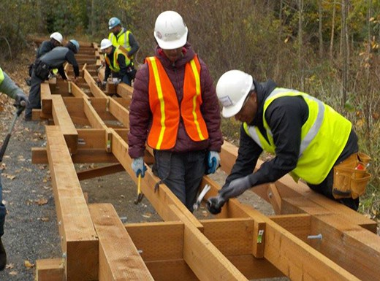
Building on the Promises
So many. Through/by Christ, we have promises
Promises
Acts 13:32-33 Promise to fathers fulfilled in Christ
And we declare unto you glad tidings, how that the promise which was made unto the fathers,God hath fulfilled the same unto us their children, in that he hath raised up Jesus again; as it is also written in the second psalm, Thou art my Son, this day have I begotten thee.
Description: great and precious – emphasis and power
By these = through these
Through these can share in divine nature

Slide 18
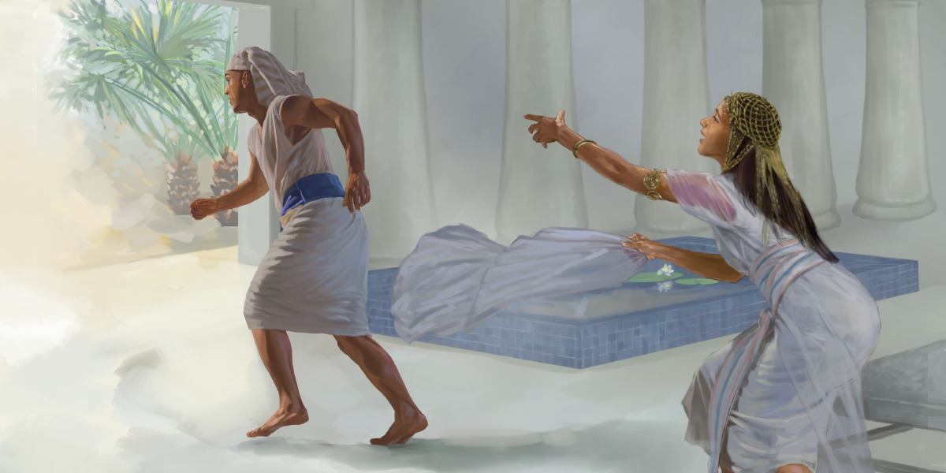
Escaping the Corruption
1 John 4:1 – Test if Promises from God
John 8:44 - Satan lies and deceives
2 Peter 2 - False teachers are sensual, arrogant, greedy, covetous
Gal 6:7-8 - Principle of Sow and reap
2 Peter 2:18-22 - Can again turn to corruption
Rom 1:23-32 – Reprobate mind

Slide 19
Partaker of the Divine Nature
Koinonos = partakers
“denoting a companion, partner, partaker” Vine III:161
“A partaker, sharer ….’ Thayer 352
Phusis “the sum of innate properties and powers by which one person differs from others, distinctive native peculiarities, natural characteristics … (the holiness distinctive of divine nature is specially referred to), 2 Pet. i.4” Thayer 661 (Bold my emphasis)

Slide 20
Partaker of the Divine Nature
Substance vs. Quality
“The qualities and characteristics of this nature are reflected in those who are obedient to the word of God.” Hamilton, 29
Jn 1:12-13 But as many as received him, to them gave he power to become the sons of God, even to them that believe on his name: Which were born, not of blood, nor of the will of the flesh, nor of the will of man, but of God.

Slide 21
Partaker of the Divine Nature
Substance vs. Quality
1 Peter 1:23 Being born again, not of corruptible seed, but of incorruptible, by the word of God, which liveth and abideth for ever.
Eph 4:21-23 That ye put off concerning the former conversation the old man, which is corrupt according to the deceitful lusts; And be renewed in the spirit of your mind; And that ye put on the new man, which after God is created in righteousness and true holiness.

Slide 22
Partaker of the Divine Nature
Substance vs. Quality
2 Cor 6:18-7:1 And will be a Father unto you, and ye shall be my sons and daughters, saith the Lord Almighty. Having therefore these promises, dearly beloved, let us cleanse ourselves from all filthiness of the flesh and spirit, perfecting holiness in the fear of God.
Do you see a parallel to 2 Peter 1:4?

Slide 23
Partaker of the Divine Nature
Substance vs. Quality
Holiness and righteousness are two attributes of God. Being in fellowship with God does NOT make one diety, but the idea of something shared or in communion is prominent.
Gal 2:20 am crucified with Christ: nevertheless I live; yet not I, but Christ liveth in me: and the life which I now live in the flesh I live by the faith of the Son of God, who loved me, and gave himself for me.

Slide 24
Partaker of the Divine Nature
Substance vs. Quality
Share or in communion is prominent.
Phil 1:21 For to me to live is Christ, and to die is gain.
John 15:4 Abide in me, and I in you. As the branch cannot bear fruit of itself, except it abide in the vine; no more can ye, except ye abide in me.
John 14:23 Jesus answered and said unto him, If a man love me, he will keep my words: and my Father will love him, and we will come unto him, and make our abode with him.

Slide 25
Partaker of the Divine Nature
Substance vs. Quality
Share or in communion is prominent.
1 John 2:23-25 Whosoever denieth the Son, the same hath not the Father: (but) he that acknowledgeth the Son hath the Father also. Let that therefore abide in you, which ye have heard from the beginning. If that which ye have heard from the beginning shall remain in you, ye also shall continue in the Son, and in the Father.And this is the promise that he hath promised us, even eternal life.
Class focused on qualities

Slide 26
The Development of Seven Graces
2 Peter 1:5-7
Briefly defined
Faith – “conviction and strong assurance”
Virtue – “moral excellence, goodness”
Knowledge – “correct insight”
Self-control - "self-discipline"
Perseverance - "bearing up under trials"
Godliness - "godly character out of devotion to God"
Brotherly Kindness - "love toward brethren"
Love - "active goodwill toward others"

Slide 27
The Development of 7 Graces
Greek word for knowledge in 2 Peter 1:2-3, 8 epignosis, means "to become thoroughly acquainted with, to know thoroughly, to know accurately, know well"
Such knowledge comes only as we demonstrate these "Christ-like” graces in our lives.
Add - Not the idea of stair steps, but rather of a chorus working in harmony to produce an overall result.

Slide 28
With All Diligence!
2 Peter 1:5
Means "earnestness, zeal, sometimes with haste"
Not "accidentally" or "naturally" develop!
Diligence requires effort and effectiveness
Diligence implies focused work on our part.
If we are not applying diligence to grow in these graces, then we are not growing and building.
Our goal is to escape corruption and become partakers of the divine nature.

Slide 29
All Things Pertaining To Life and Godliness Are Provided
If we desire to have all that God offers related to life and godliness, it comes as we develop the Christ-like character!
Thought question: How are we using God’s great and precious promises to escape the corruption in th world, grow, and become partakers of the divine nature? On what promises do we stand?

Slide 30

Spiritual “Myopia” Avoided
Our religion is "shortsighted" to blindness if we are not growing in the knowledge of Jesus! Each of these helps battle against myopia/blindness. 2 Peter 1:9
Romans 8:28-29And we know that all things work together for good to them that love God, to them who are the called according to his purpose. ²⁹ For whom he did foreknow, he also did predestinate to be conformed to the image of his Son, that he might be the firstborn among many brethren.
Colossians 3:9-11 Lie not one to another, seeing that ye have put off the old man with his deeds;¹⁰ And have put on the new man, which is renewed in knowledge after the image of him that created him:¹¹ Where there is neither Greek nor Jew, circumcision nor uncircumcision, Barbarian, Scythian, bond nor free: but Christ is all, and in all.

Slide 31
We Will Never Fall
2 Peter 1:10 - “stumble”
This does not mean we will never sin.
1 John 1:8-10 If we say that we have no sin, we deceive ourselves, and the truth is not in us.⁹ If we confess our sins, he is faithful and just to forgive us our sins, and to cleanse us from all unrighteousness. ¹⁰ If we say that we have not sinned, we make him a liar, and his word is not in us.
"to fall into misery, become wretched; cf. the loss of salvation"
But this assurance is true only if we are "giving all diligence" to grow in the knowledge of Christ and thereby "making our calling and election sure"

Slide 32
Next Week
Escaping the corruption in the world through lust
(Sin and grace)

